Slide 1
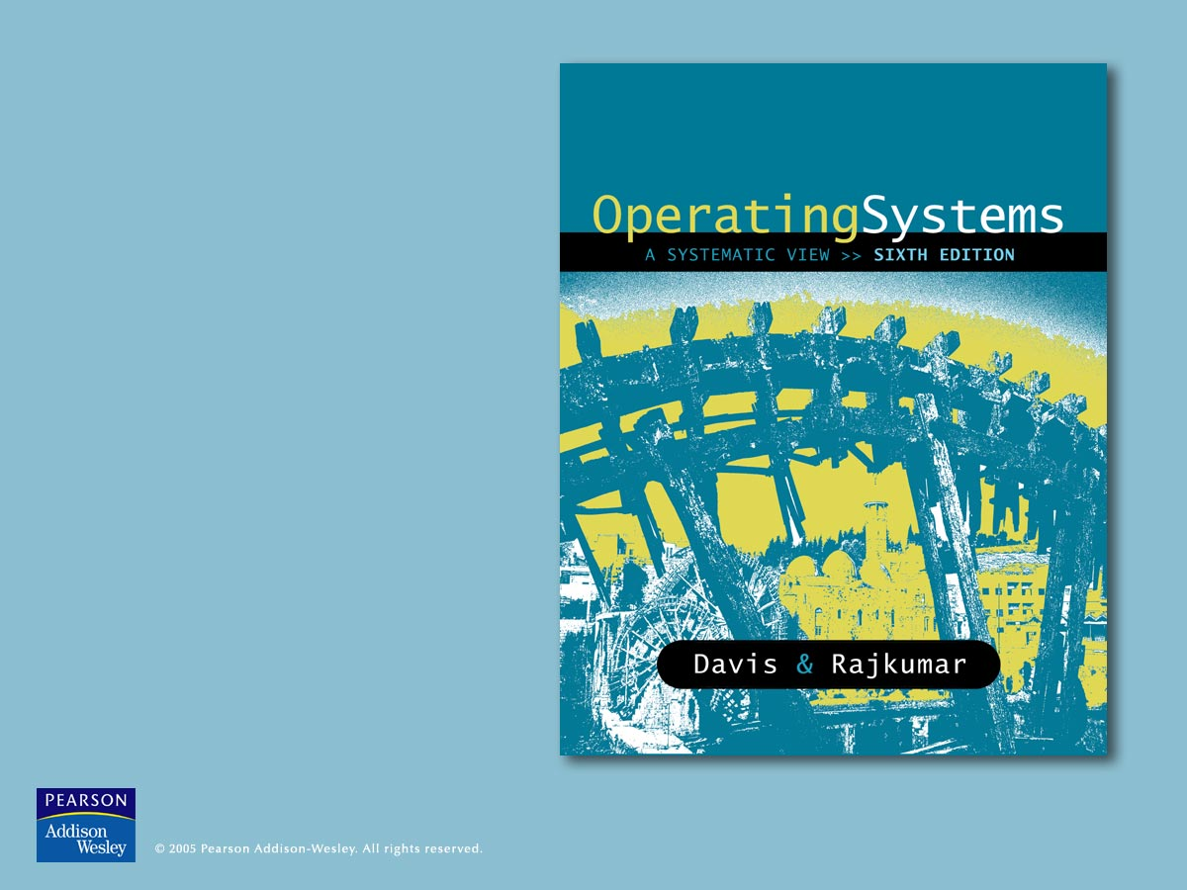
11
MS-DOS Internals

Slide 2

MS-DOS
At one time, the world’s most common microcomputer operating system
Absorbed by Windows
  Earlier version of Windows ran on top of DOS
Line commands still available
  The Windows XP command line
  See Chapter 7

Slide 3
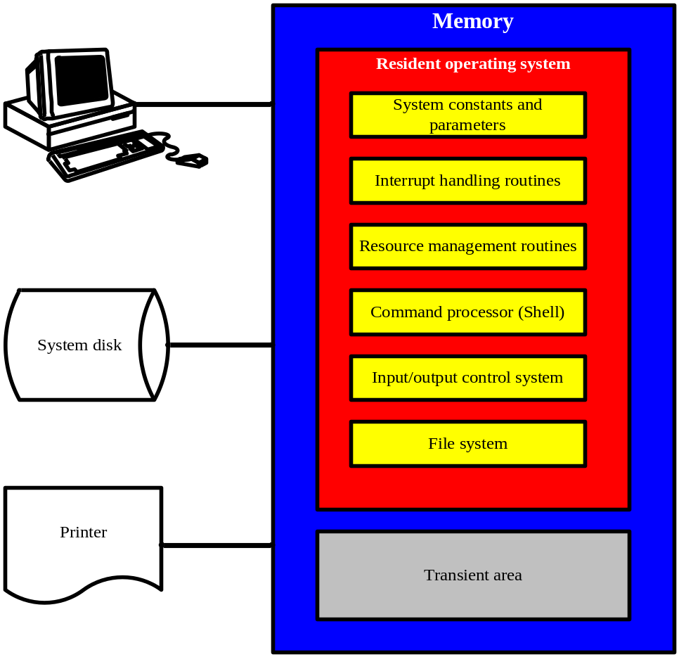
Figure 11.1 The components of a typical operating system.
Resident OS routines
  Kernel/Supervisor
  In memory at all times
    Shell: not part of Kernel
  Support system programs and application
Transient OS routines
  In memory as needed
  Ex. Format
  Applications

Slide 4
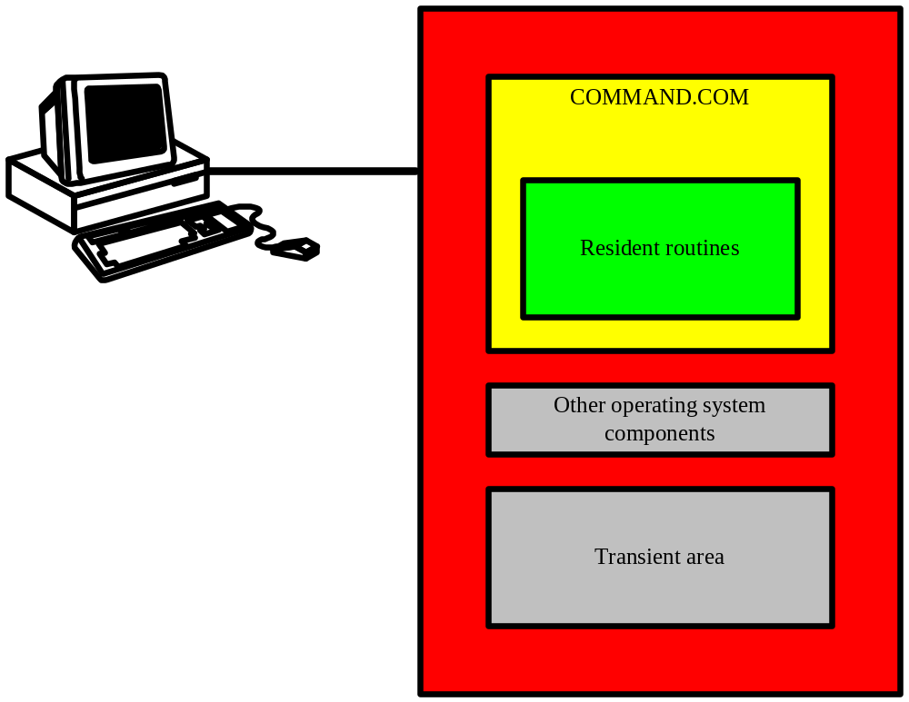
Figure 11.2 The MS-DOS command processor is called COMMAND.COM.
MS-DOS is command driven
Shell interprets the commands and calls the appropriate OS module

Slide 5
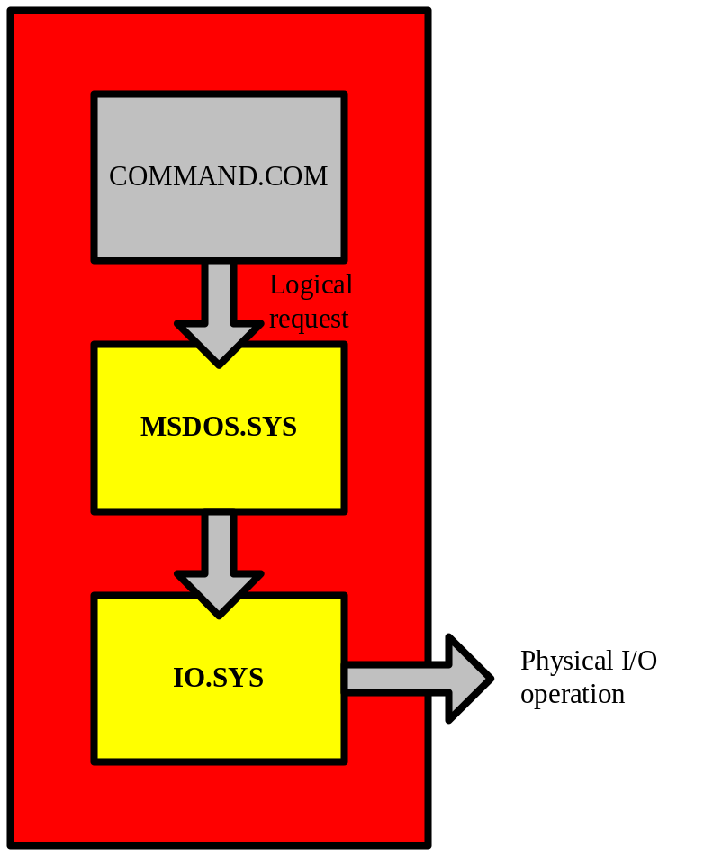
Figure 11.3 IO.SYS and MSDOS.SYS share responsibility for communicating with peripheral devices.
IO.SYS
  Hardware dependent
  Physical I/O
  Interacts with BIOS
MSDOS.SYS
  Hardware independent
  Logical I/O

Slide 6
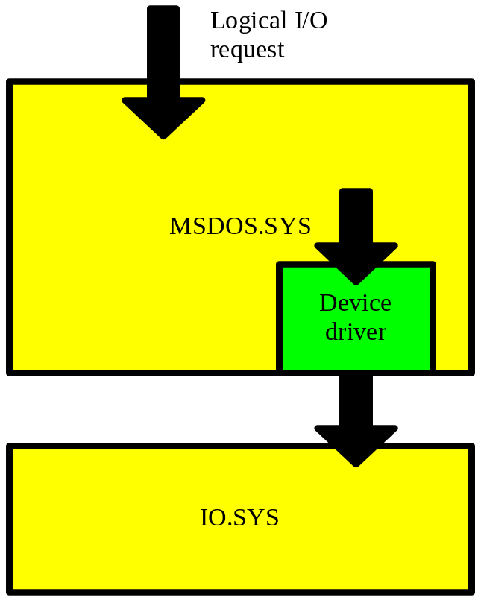
Figure 11.4 MSDOS.SYS uses a device driver to translate logical I/O requests to physical form.
Device driver
  Special file that describes each device attached to the system
Types of Drivers
  Character drivers control
    Keyboard, Screen, Printer
  Block drivers control
    Disk
    512-byte blocks
Drivers for standard devices are built into OS
CONFIG.SYS
  System file
  Device descriptions
  See supplemental lecture notes for example

Slide 7
The file system (MSDOS.SYS)
Converts logical I/O to physical form
Performs directory management
Allocates space on disk
Supports application programs

Slide 8
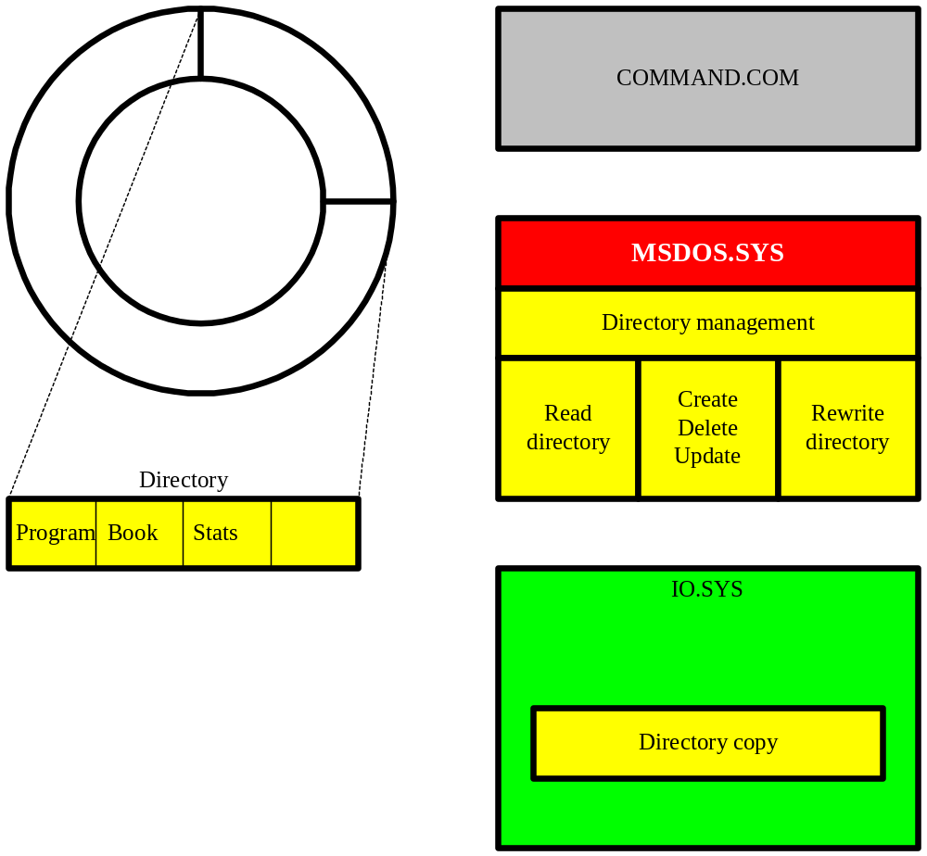
Figure 11.5 MSDOS.SYS is responsible for directory management.
A:\> MKDIR LETTERS
Following MKDIR, COMMAND.COM calls MSDOS.SYS.

Slide 9
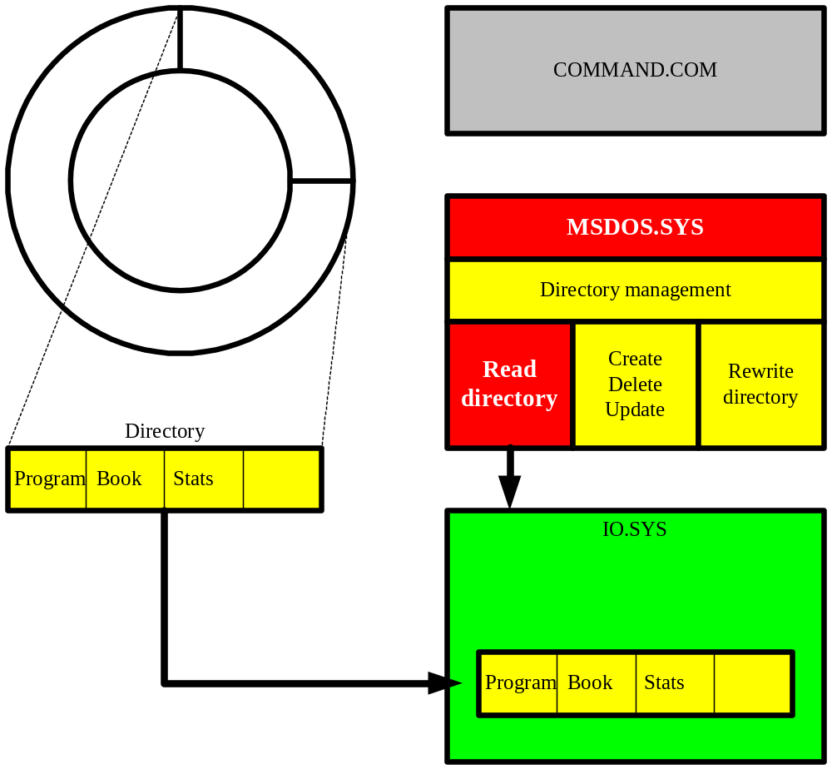
b. MSDOS.SYS calls IO.SYS to read the directory.

Slide 10
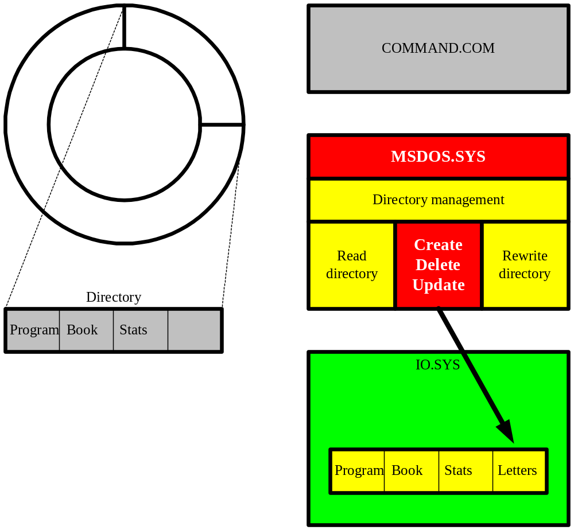
c. MSDOS.SYS adds a new directory entry.

Slide 11
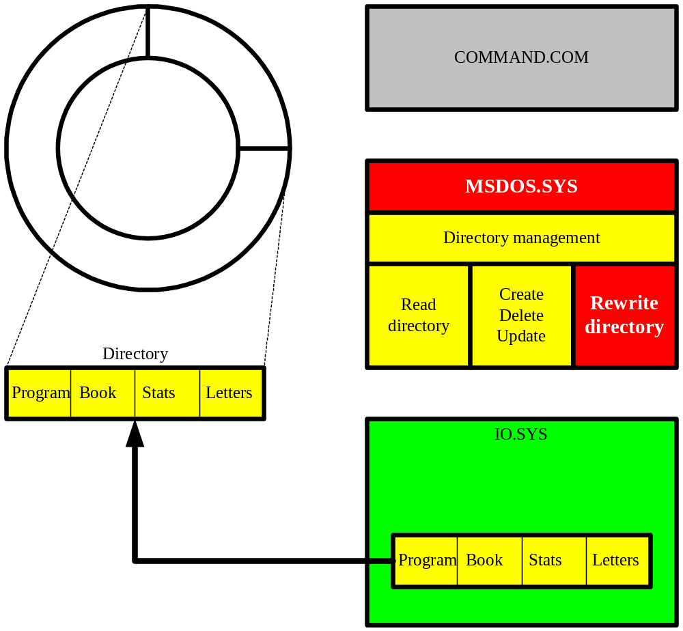
d. MSDOS.SYS calls IO.SYS to rewrite the directory to disk.

Slide 12
The file system (MSDOS.SYS)
Supports application program I/O
  OPEN file
    MSDOS.SYS calls IO.SYS to read directory and FAT from disk
    Extracts location of existing file or creates directory entry for new file
  READ/WRITE from/to file
    Program calls MSDOS.SYS
    MSDOS.SYS extracts file’s starting address from disk directory and then from FAT
    MSDOS.SYS calls IO.SYS to read/write data from/to disk
  CLOSE file
    MSDOS.SYS updates the directory and FAT
    Calls IO.SYS to rewrite the directory and FAT to disk

Slide 13
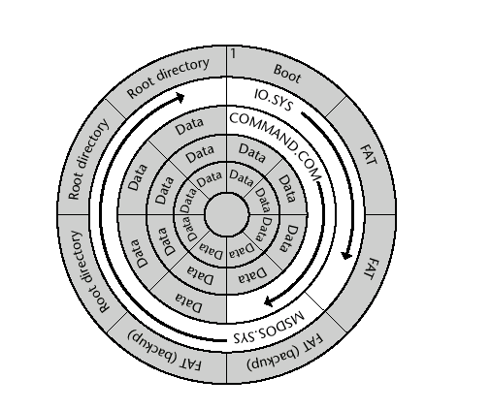
Figure 11.6 The format of a typical MS-DOS system disk.
MSDOS.SYS
  Allocates space
  Clusters
File allocation table (FAT)

Slide 14
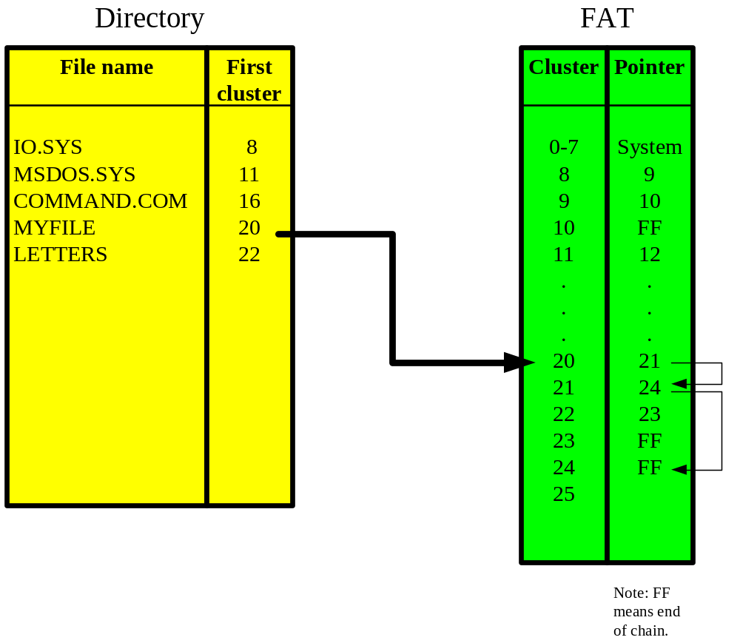
Figure 11.7 A file’s clusters are linked by a chain of pointers in the file allocation table.
OS views data as stream of bytes
1st cluster store bytes 0-1023, 2nd: 1024-2047
Noncontiguous clusters are typically allocated

Slide 15
Interrupt
DOS relies on interrupts to establish communication with its peripheral devices
An electronic signal that results in the forced transfer of control to an interrupt handler
  Source: hardware or software
Up to 256 different interrupt handlers
  Found in MSDOS.SYS or IO.SYS
Processing interrupts is a very important DOS function

Slide 16
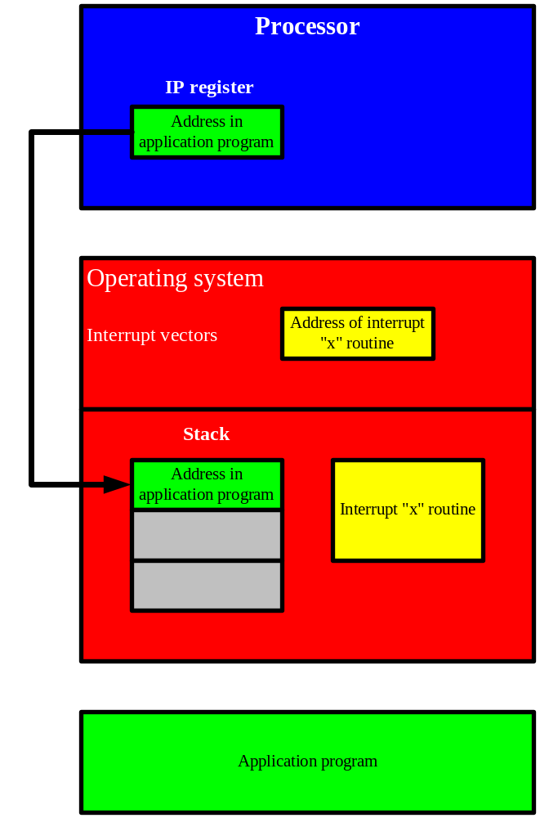
Figure 11.8 MS-DOS interrupt processing. a. The contents of the instruction pointer (IP) register are copied to the stack.

Slide 17
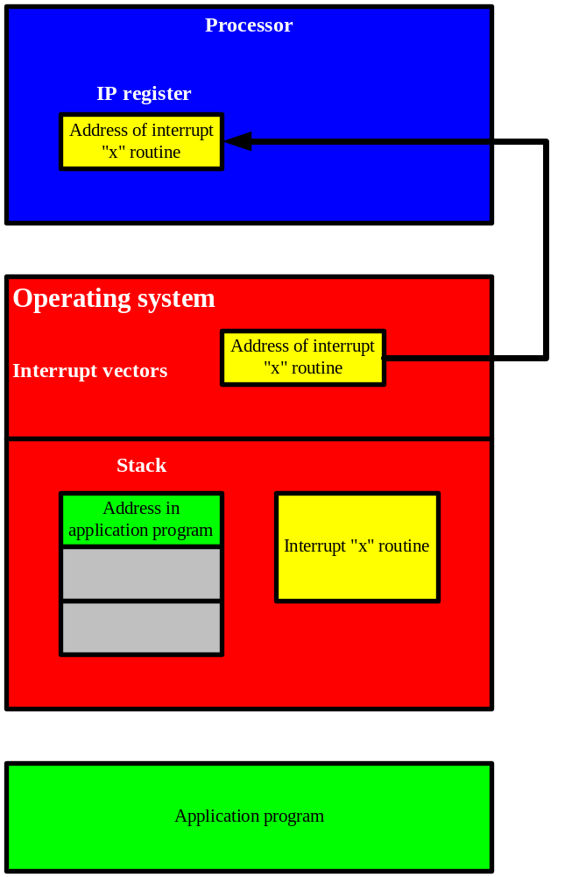
b. The specified interrupt vector is loaded into the instruction pointer.

Slide 18
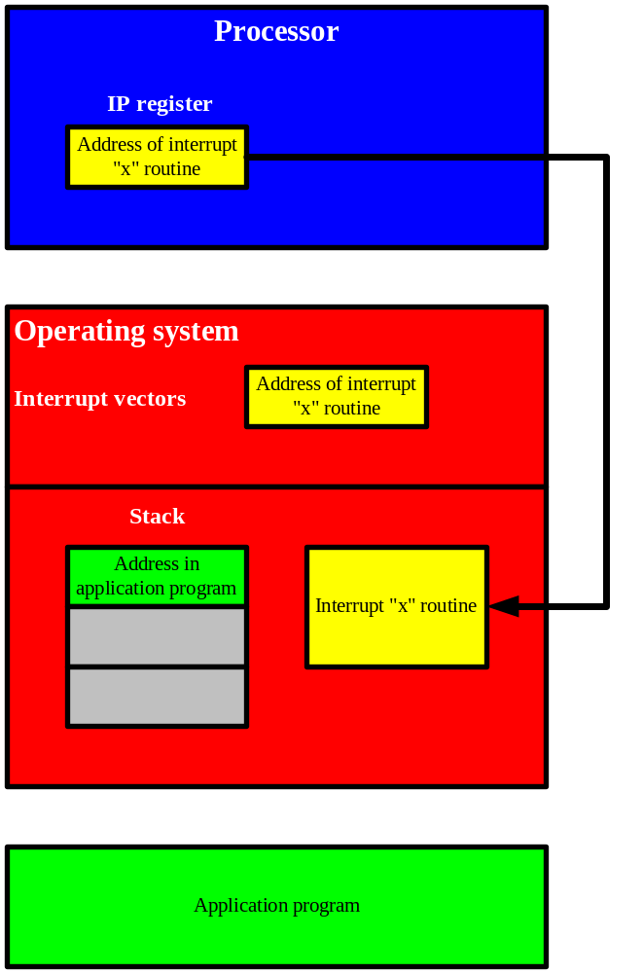
c. The first instruction in the interrupt processing routine is fetched.

Slide 19
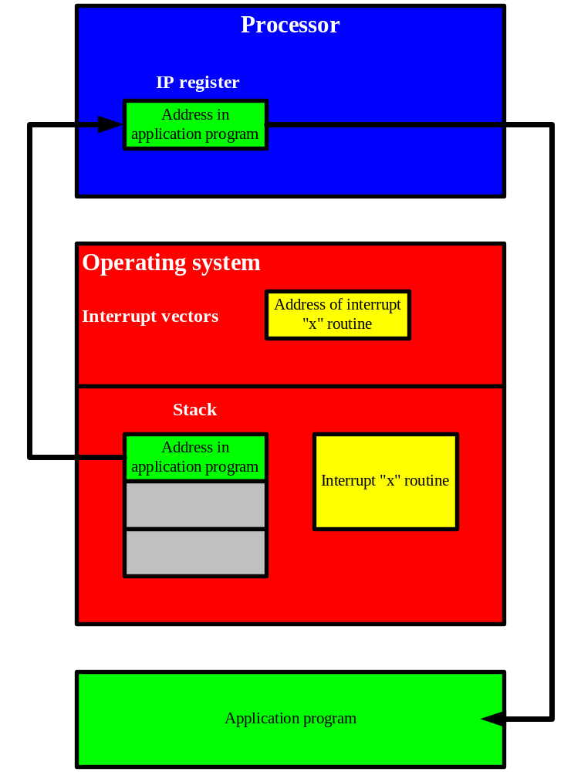
d. The contents of the stack are loaded back into the instruction pointer register and the application program resumes processing.

Slide 20
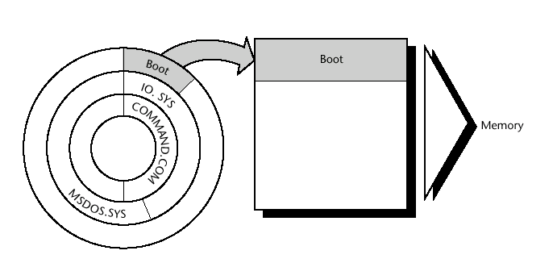
Figure 11.9 Hardware reads the boot routine from the first sector on the system disk.

Slide 21
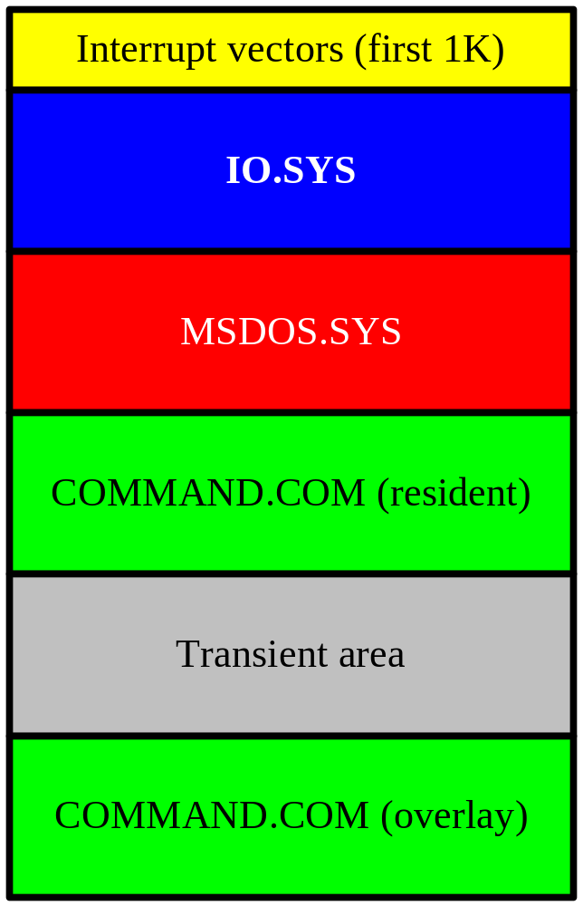
Figure 11.10 The contents of memory after MS-DOS is booted.

Slide 22
Running MS-DOS
Operating system booted
  Initial system prompt displayed
User enters a command
  Enter key generates interrupt
COMMAND.COM carries out command
  Call other MS-DOS components as necessary
  Example: load and start application
System waits for next command

